Slide 1
Frame Relay
Connecting Networks (CCNA4)– Chapter 3

Slide 2
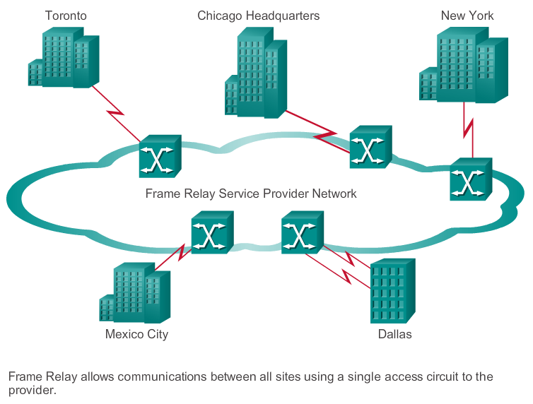
Frame Relay Technology
Frame Relay is a packet-switched, connection-oriented, WAN service. It operates at the data link layer of the OSI reference model.

Slide 3
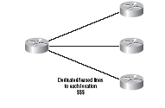
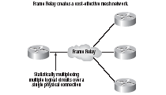
Before and After
Saves cost.
But there is one single point of failure, which is not so good.
But Frame Relay is used to save money, not to make a network more resilient.

Slide 4
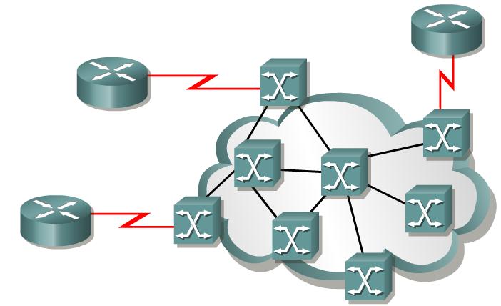
Introducing Frame Relay
T1/E1 lease line
Access circuits
It typically consists of many geographically scattered Frame Relay switches interconnected by trunk lines.
Frame Relay is often used to interconnect LANs. When this is the case, a router on each LAN will be the DTE.
A serial connection, such as a T1/E1 leased line, will connect the router to a Frame Relay switch of the carrier at the nearest point-of-presence for the carrier. (access circuit)

Slide 5
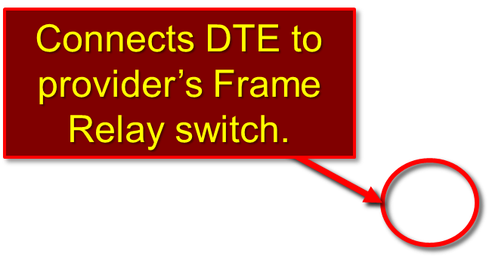
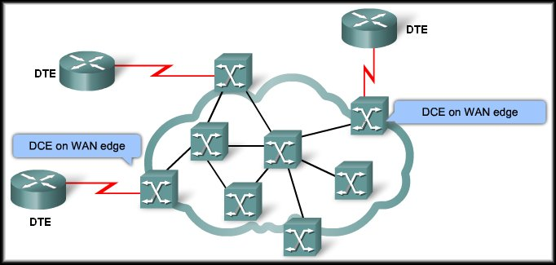
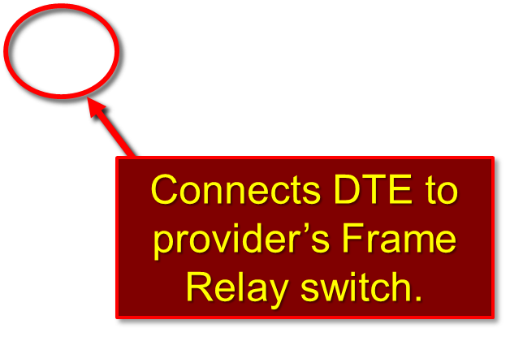
Frame Relay Operation

Slide 6
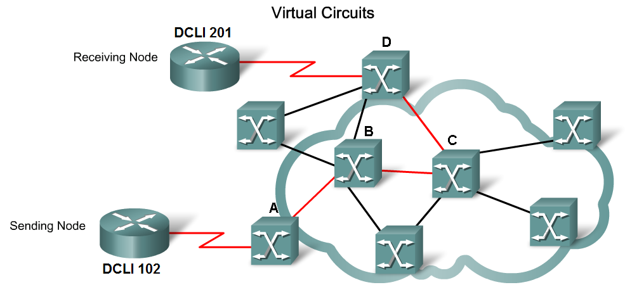
Virtual Circuits
Frame Relay uses virtual circuits to carry packets from one DTE to another.
Switched VC and Permanent VC
Animation

Slide 7
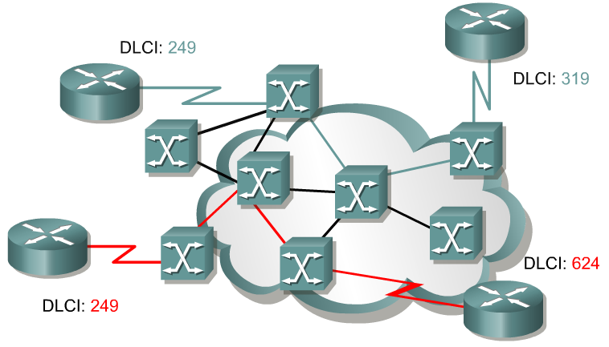
Frame Relay terminology
An SVC between the same two DTEs may change.
A PVC between the same two DTEs will always be the same.
Path may change.
Always same Path.
Switched Virtual Circuits (SVCs) are Virtual circuits may be established dynamically by sending signaling messages to the network.
However, SVCs are not very common.
Permanent Virtual Circuits (PVCs) are more common.
PVC are VCs that have been preconfigured by the carrier are used.
The switching information for a VC is stored in the memory of the switch.

Slide 8
Multiple Virtual Circuits
Any single site can communicate with any other single site without using multiple dedicated physical lines.
Toronto
Vancouver
Each site only pays for their connection to the provider’s DCE.
Windsor

Slide 9
Identifying Virtual Circuits (VC)
As the frame moves across the network, Frame Relay labels each VC with a DLCI (Data Link Connection Identifiers).
The DLCI is stored in the address field of every frame to tell the network how the frame should be routed.

Slide 10
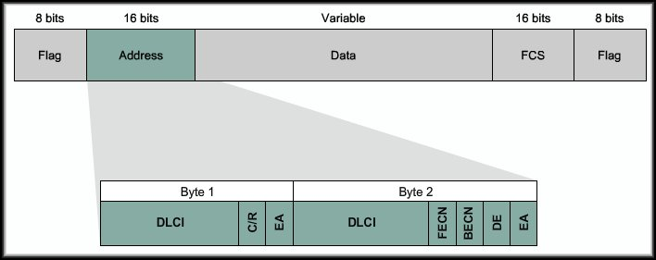
Frame Relay Encapsulation
Frame Relay takes data packets from a network layer protocol and encapsulates them as the data portion of a Frame Relay frame.
DLCI spans 2 bytes

Slide 11
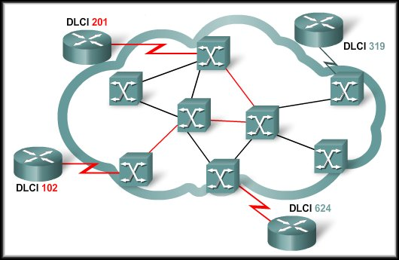
Local Significance of DLCIs
A DLCI simply identifies a VC to the equipment at an endpoint and is only unique on the physical channel where they reside.

Slide 12
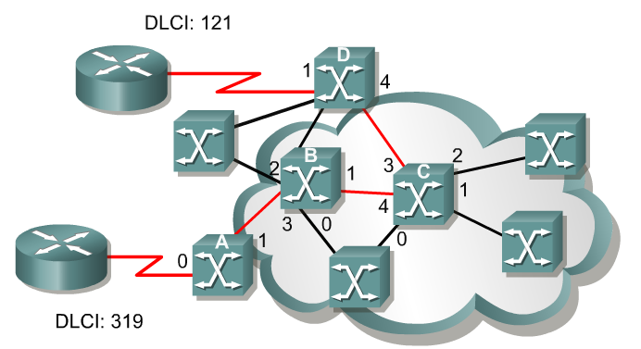
DLCI
DLCIs 0 to 15 and 1008 to 1023 are reserved for special purposes.
Service providers assign DLCIs in the range of 16 to 1007.
  DLCI 1019, 1020: Multicasts
  DLCI 1023: Cisco LMI
  DLCI 0: ANSI LMI

Slide 13
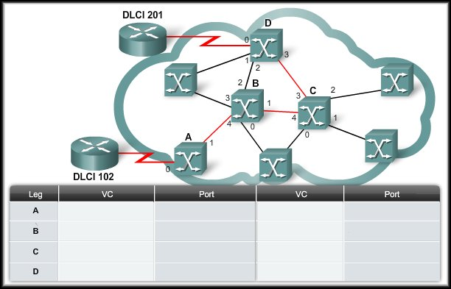
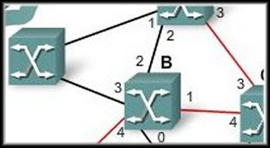
Identifying Virtual Circuits (VC)
VC | Port | DLCI
21 | 0 | 222
22 | 1 | 119
23 | 2 | 309
24 | 3 | 721
25 | 4 | 432
Each Frame Relay switch will have a table that is used to build the virtual circuit.
As the frame moves through the switch, the DLCI is adjusted to follow the predetermined path through the network.

Slide 14
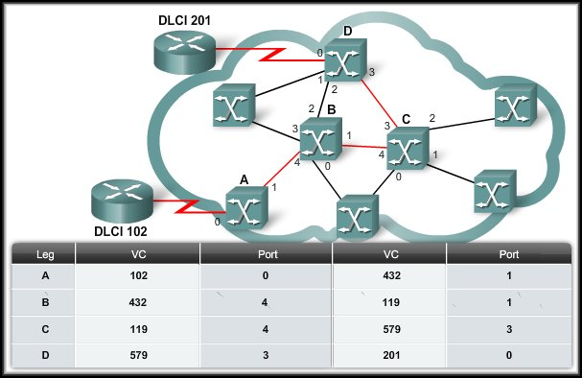
Identifying Virtual Circuits (VC)

Slide 15
Frame Relay Topologies
A topology is the map or visual layout of the network.
  You need to consider the topology from to understand the network and the equipment used to build the network.
  Every network or network segment can be viewed as being one of three topology types:
    Star (Hub and Spoke)
    Full Mesh
    Partial Mesh

Slide 16
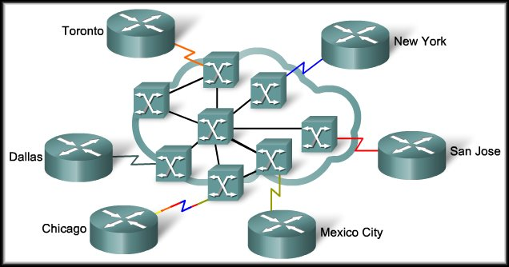
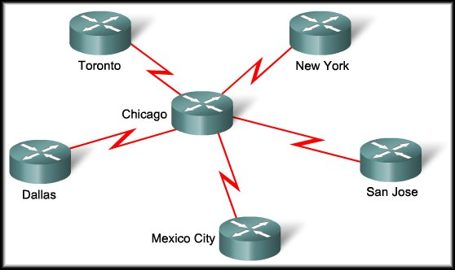
Frame Relay Topologies
Star ( Hub and Spoke):
  The simplest WAN topology.
  A central site that acts as a hub and hosts the primary services.
One site with multiple VCs

Slide 17
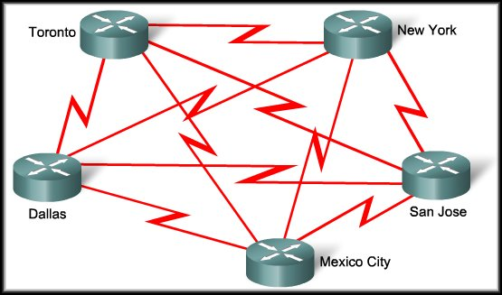
Frame Relay Topologies
Full Mesh:
  A full mesh topology connects every site to every other site. Using leased-line interconnections, additional serial interfaces and lines add costs.
Formula [n(n - 1)]/2
# Sites | # Circuits
2 | 1
3 | 3
4 | 6
5 | 10
6 | 15
7 | 24

Slide 18
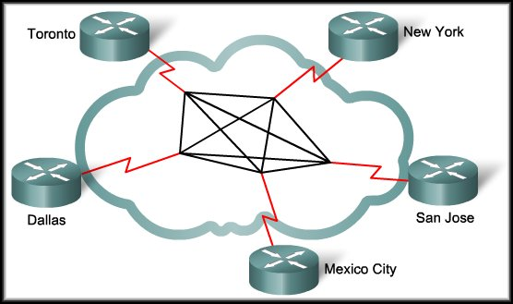
Frame Relay Topologies
Full Mesh:
  Using Frame Relay, a network designer can build multiple connections simply by configuring additional VCs on each existing link.
  No additional
  expense for
  communication
  lines or
  hardware.

Slide 19
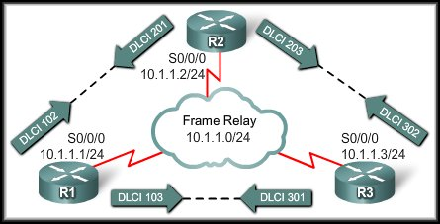
Frame Relay Address Mapping
Before a router is able to transmit data over Frame Relay, it needs to know which local DLCI maps to the Layer 3 address of the remote destination.

Slide 20
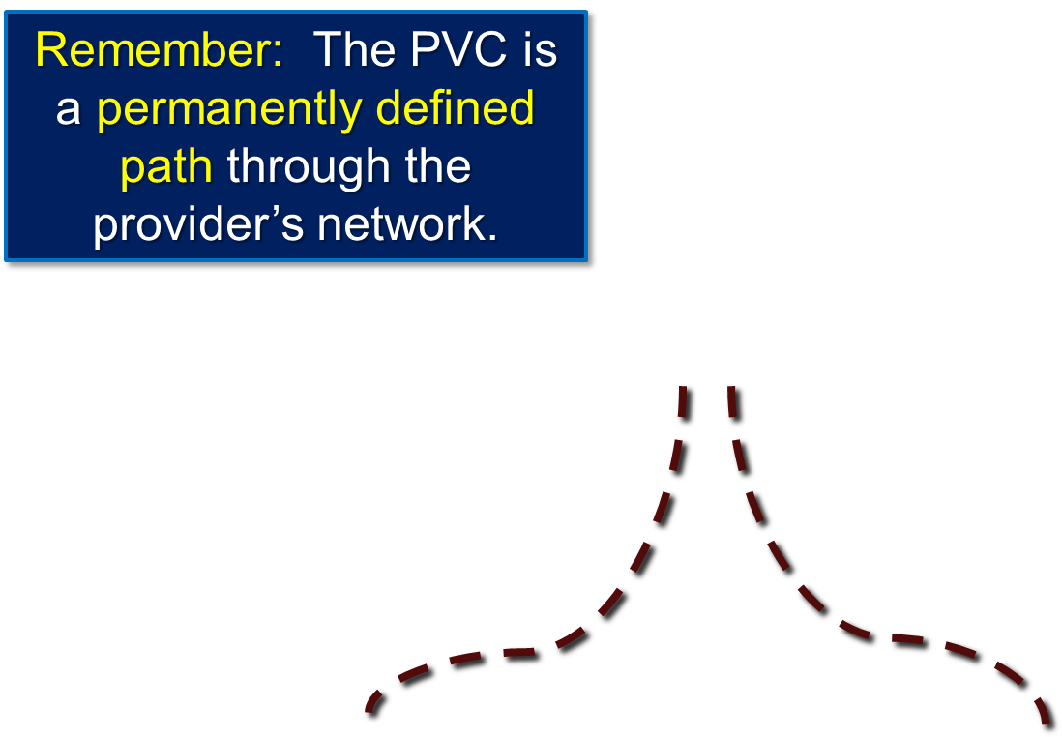
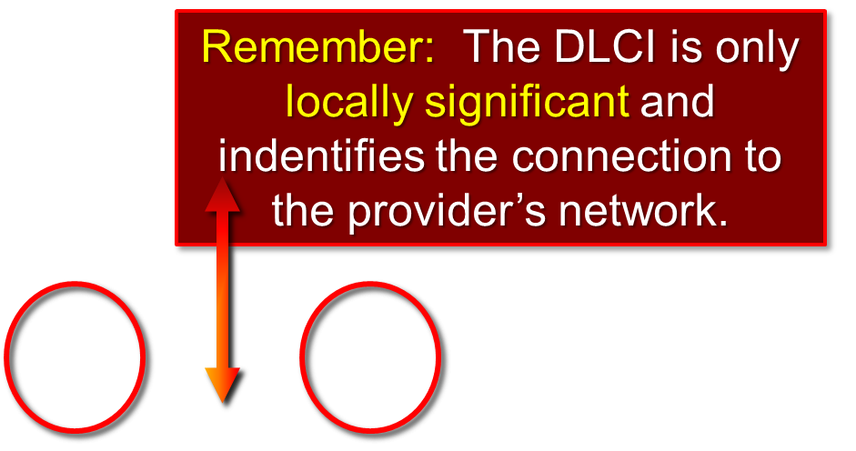
Frame Relay Address Mapping – WHY?
When R2 has a packet to transmit, it must know which DLCI to put in the header at Layer 2.

Slide 21
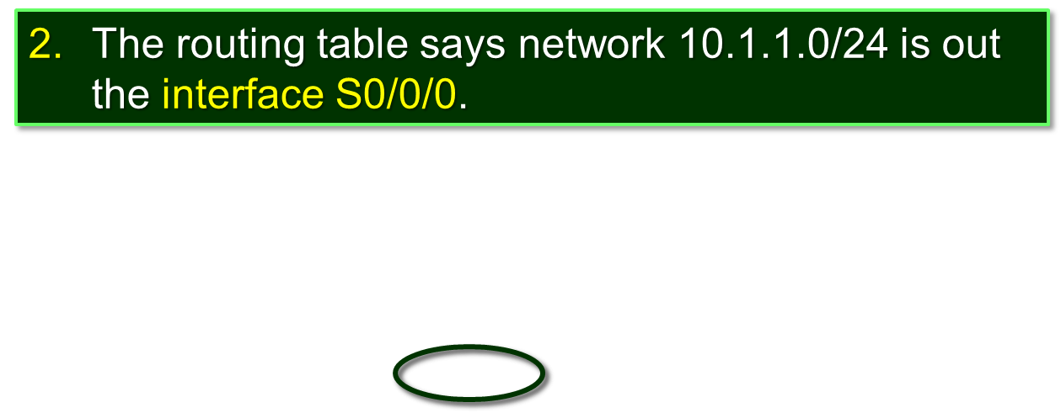
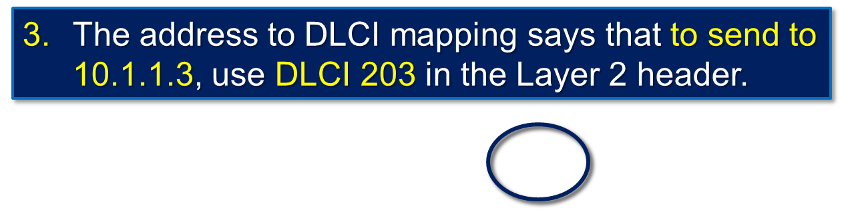
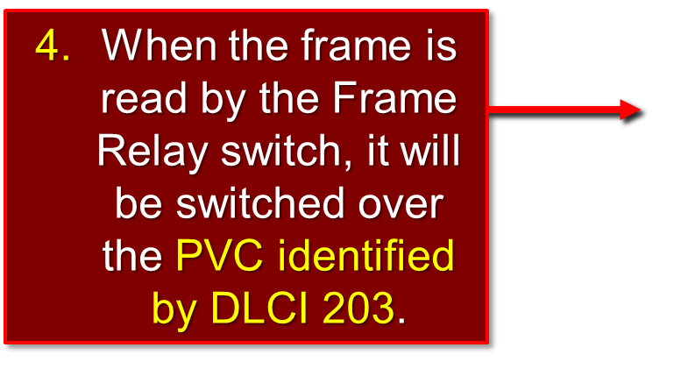
Frame Relay Address Mapping - WHY?
R2 has a packet to transmit to 10.1.1.3.

Slide 22
Frame Relay Address Mapping
Before a router is able to transmit data over Frame Relay, it needs to know which local DLCI maps to the Layer 3 address of the remote destination.
  Two Methods:
    Dynamic Address Mapping.
    Static Address Mapping.

Slide 23
Frame Relay Address Mapping
Dynamic Address Mapping:
  Uses Inverse ARP (IARP).
    ARP: Layer 3 address to obtain Layer 2 address.
    IARP: Layer 2 address to obtain Layer 3 address.
      In the case of Frame Relay, IARP uses the Layer 2 DLCI to obtain the Layer 3 address of the router at the other end of the PVC.
  On Cisco routers, Inverse ARP is enabled by default.

Slide 24
Frame Relay Address Mapping
Static Address Mapping:
  Override Dynamic IARP mapping by supplying a manual static mapping for the next hop protocol address to a local DLCI.
  A static map works associates a specified next hop protocol address to a local Frame Relay DLCI.

Slide 25
Local Management Interface (LMI)
History:
  When vendors implemented Frame Relay as a separate technology, they decided that there was a need for DTEs to dynamically acquire information about the status of the network.
  The original design did not include this option.
  A consortium of Cisco, Digital Equipment Corporation (DEC), Northern Telecom, and StrataCom extended the Frame Relay protocol to provide additional capabilities for complex internetworking environments.
These extensions are referred to collectively as the LMI.

Slide 26
Local Management Interface (LMI)
Basically, the LMI is a keepalive mechanism that provides status information about Frame Relay connections between the router (DTE) and the Frame Relay switch (DCE).
  Every 10 seconds or so, the end device polls the network.
  If the network does not respond with the requested information, the user device may consider the connection to be down.
  When the network responds with a FULL STATUS response, it includes status information about DLCIs that are allocated to that line.
  The end device can use this information to determine whether the logical connections are able to pass data.

Slide 27
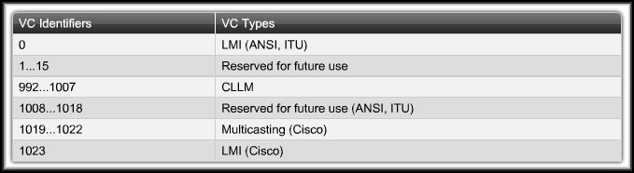
Local Management Interface (LMI)
The 10-bit DLCI field supports 1,024 VC identifiers:
  0 through 1023.
The LMI extensions reserve some of these identifiers, thereby reducing the number of permitted VCs.
  LMI messages are exchanged between the DTE and DCE using these reserved DLCIs.

Slide 28
Local Management Interface (LMI)
There are several LMI types, each of which is incompatible with the others.
  Three types of LMIs are supported by Cisco routers:
    Cisco - Original LMI extension
    Ansi - Corresponding to the ANSI standard T1.617 Annex D
    q933a - Corresponding to the ITU standard Q933 Annex A

Slide 29
Local Management Interface (LMI)
Starting with Cisco IOS software release 11.2, the default LMI autosense feature detects the LMI type supported by the directly connected Frame Relay switch.
  If it is necessary to set the LMI type, use the interface configuration command:
  frame-relay lmi-type [cisco | ansi | q933a]
  Configuring the LMI type, disables the autosense feature.

Slide 30
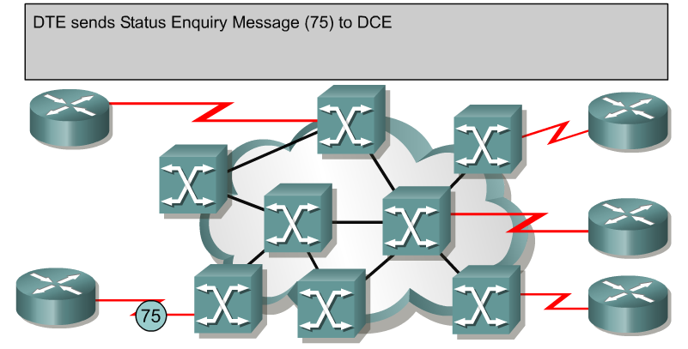
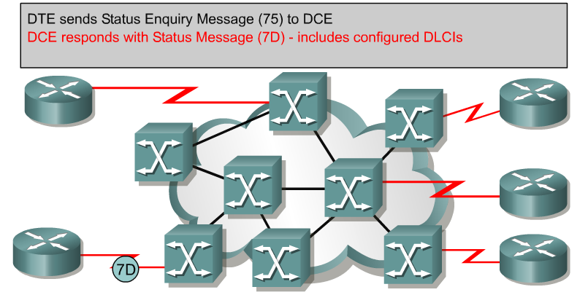
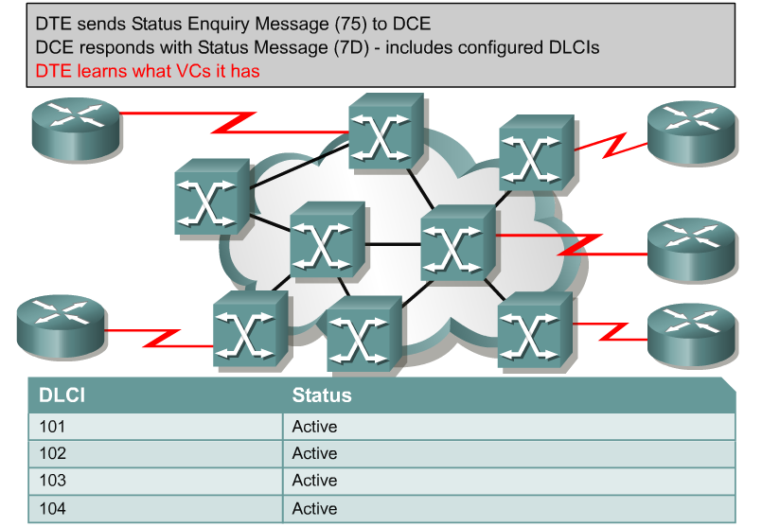
Stages of Inverse ARP and
LMI Operation #1

Slide 31
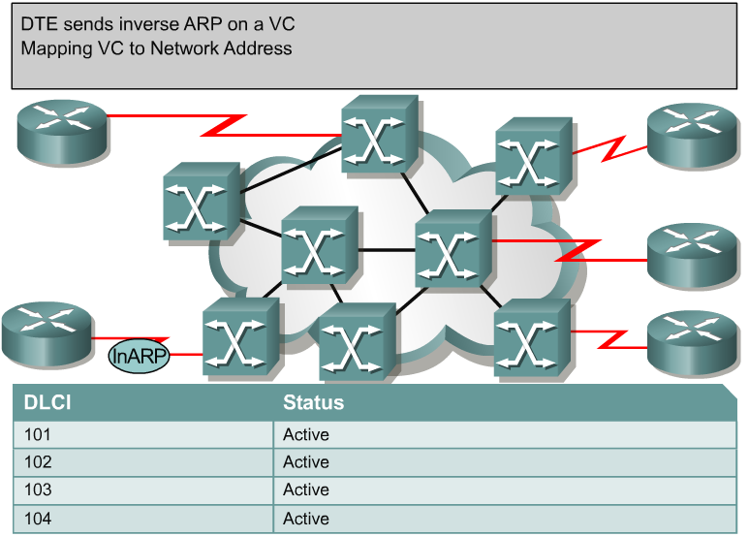
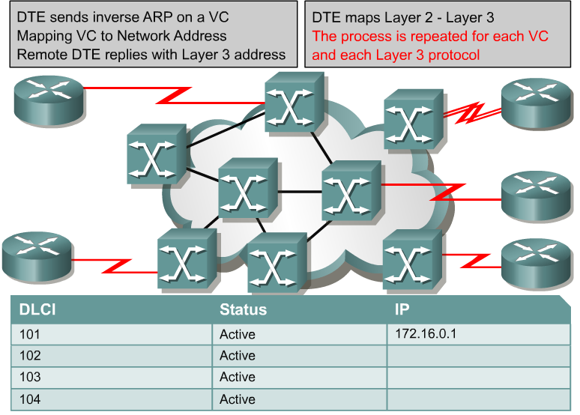
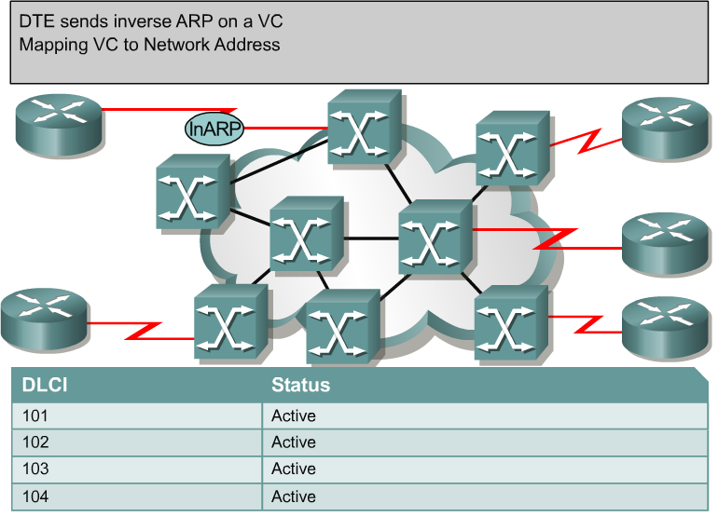
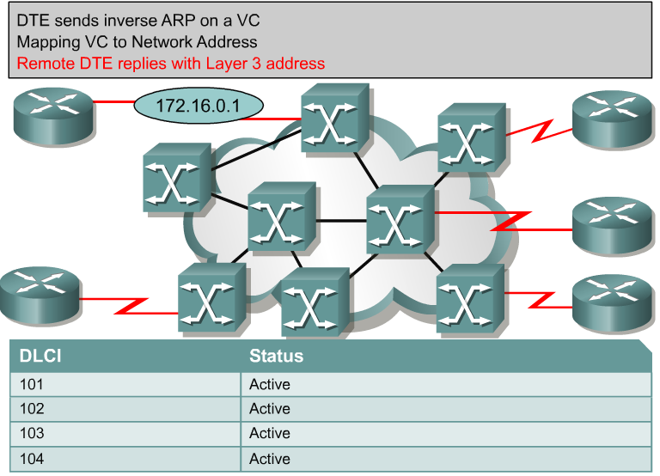
Stages of Inverse ARP and
LMI Operation #2

Slide 32
Frame Relay
Configuring Frame Relay

Slide 33
Configuring Basic Frame Relay
  Set up the IP address on the Interface.
  Configure Frame Relay encapsulation.
    encapsulation frame-relay [cisco | ietf]
    The default encapsulation is Cisco HDLC. Use IETF if connecting to another vendor’s router.
  Set the bandwidth.
    Use the bandwidth command to set the bandwidth for OSPF and EIGRP routing protocols.
  Set the LMI type (optional). (Auto detects the LMI)
  frame-relay lmi-type [cisco | ansi | q833a]

Slide 34
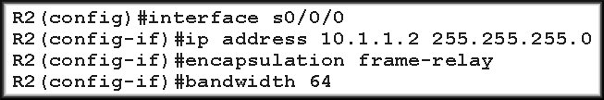
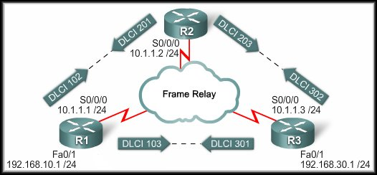
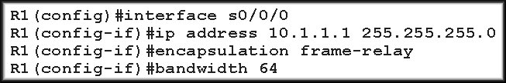
Configuring Basic Frame Relay

Slide 35
Configuring Basic Frame Relay
Once the interfaces are enabled with the no shutdown command:
  The Frame Relay switch and the router exchange LMI status messages that announce the DLCIs to the router.
  IARP maps the remote Layer 3 address to the local DLCI.
  Routers can exchange data.

Slide 36




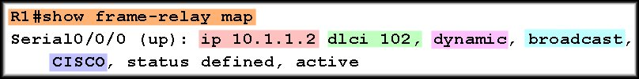
Configuring Basic Frame Relay

Slide 37
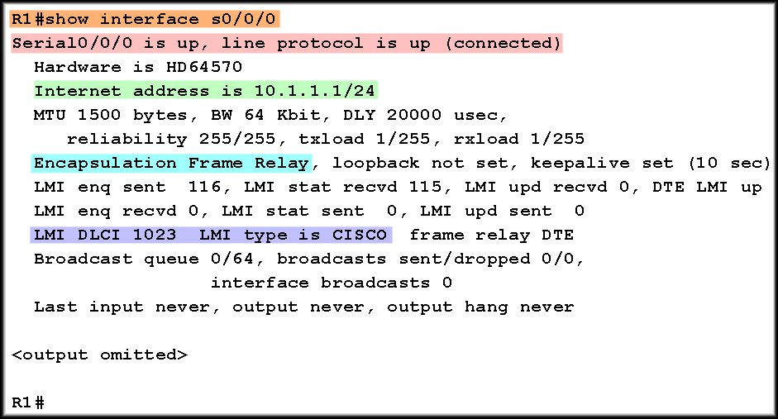
Configuring Basic Frame Relay

Slide 38
Configuring Basic Frame Relay
We used IARP to obtain the DLCI to IP Address mapping.
Remember that IARP only works between point-to-point routers.

Slide 39
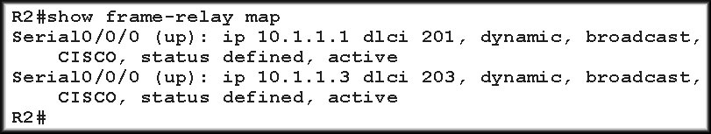
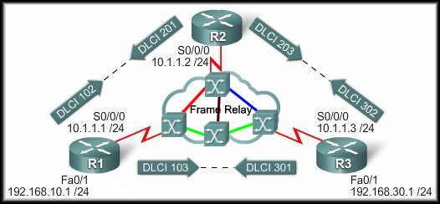
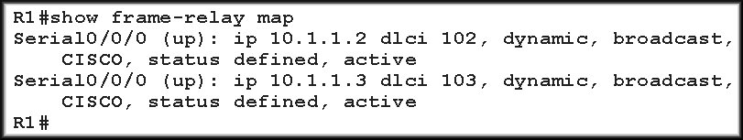
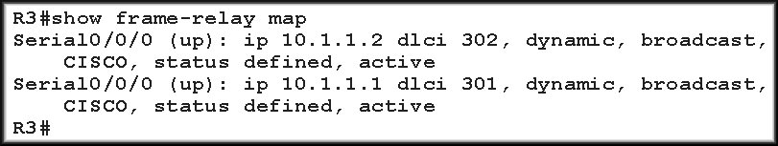
Configuring Basic Frame Relay
PVCs
Full Mesh

Slide 40
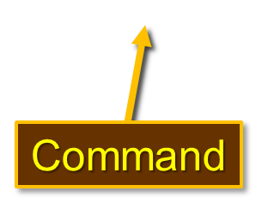
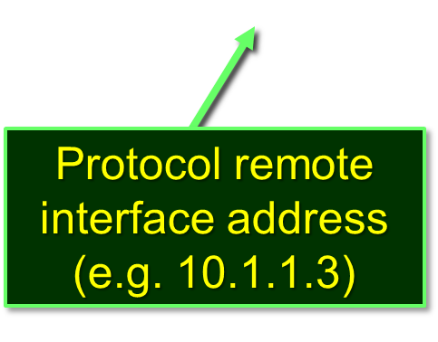

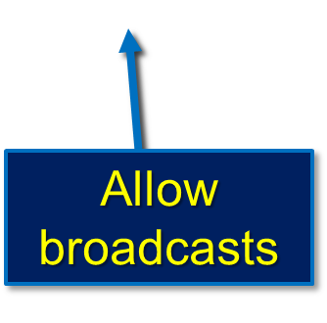
Configuring Static Frame Relay Maps
  To manually map between a next hop protocol address and a DLCI destination address, use the command:
Protocol used on the interface (e.g. IP)

Slide 41
Configuring Static Frame Relay Maps
Frame Relay (and x.25 and ATM) is a non-broadcast multiple access (NBMA) network.
  It does not support multicast or broadcast traffic.
  Using the broadcast keyword is a simplified way to forward routing updates.
    Allows broadcasts and multicasts over the PVC.
  In effect, it turns the broadcast into a unicast do that the other node gets the routing updates.

Slide 42
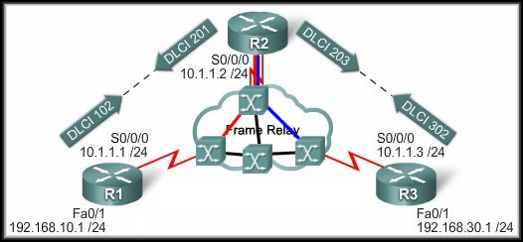

Configuring Static Frame Relay Maps
No PVC between R1 and R3.

Slide 43
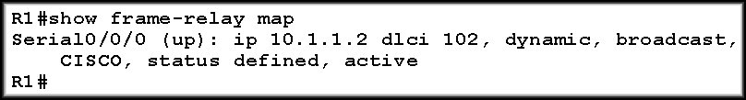
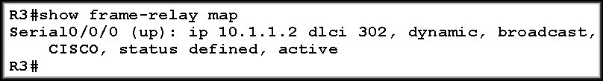
Configuring Static Frame Relay Maps
R1 and R3 know about R2.
R1 and R3 don’t know about each other.
No PVC between R1 and R3.

Slide 44


Configuring Static Frame Relay Maps
How do we fix it?
  Add another PVC to
  the network.
    Additional
    Expense.
  Add a static frame relay map to both R1 and R3.
    R1:
      We will want to map the R3 IP Address 10.1.1.3 to DLCI 102 on R1. Anything for that network should go to the hub.
    R3:
      Map 10.1.1.1 to DLCI 302.

Slide 45
Configuring Static Frame Relay Maps

Slide 46
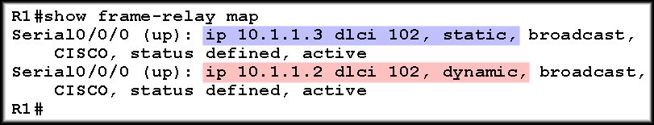
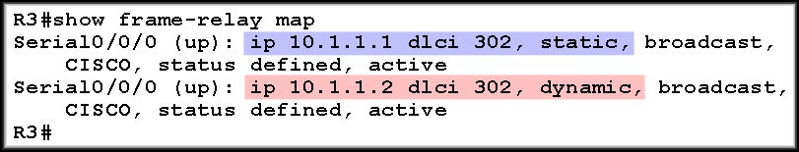
Configuring Static Frame Relay Maps

